Slide 1
GIT Basics
Dr. Frank Walsh

Slide 2


What’s GIT
Distributed Version Control
Directory Content Management
Source Control Management (Git SCM)
Use it to keep track of your stuff!
  Not just code!!! (docs, pdfs, images)
I get confused!!!

Slide 3
Git is “distributed”
Central Server
Remote Server

Slide 4
Installing Git
See Lab or…
https://git-scm.com/book/en/v2/Getting-Started-Installing-Git

Slide 5
Initialising a Repo locally (command line)
Initialises current directory as “working directory”. Creates .git directory – that’s your empty local repo.
$ mkdir myproject
$ cd myproject
$ git init
Initialized empty Git repository in C:/Users/Frank/myproject/.git/
$ git config --global user.name “fxwalsh“
$ git config --global user.email fxwalsh@wit.com
$ touch README.md
$ git add --all
$ git commit -m 'initial commit'
[master (root-commit) 7d738f4] initial commit
1 file changed, 1 insertion(+)
create mode 100644 README.md
Configures the default user name and email. Used to track repo actions

Slide 6
Clone a remote git repository
git clone url someLocalDirectory
This will create the given someLocalDirectory with a working copy of the files from the repo, and a .git directory (your local repo)
someLocalDirectory
Working Copy
Local Repo (.git dir)
Remote Repo
Local repo will be in the .git directory
Working copy of files will be in someLocalDirectory

Slide 7
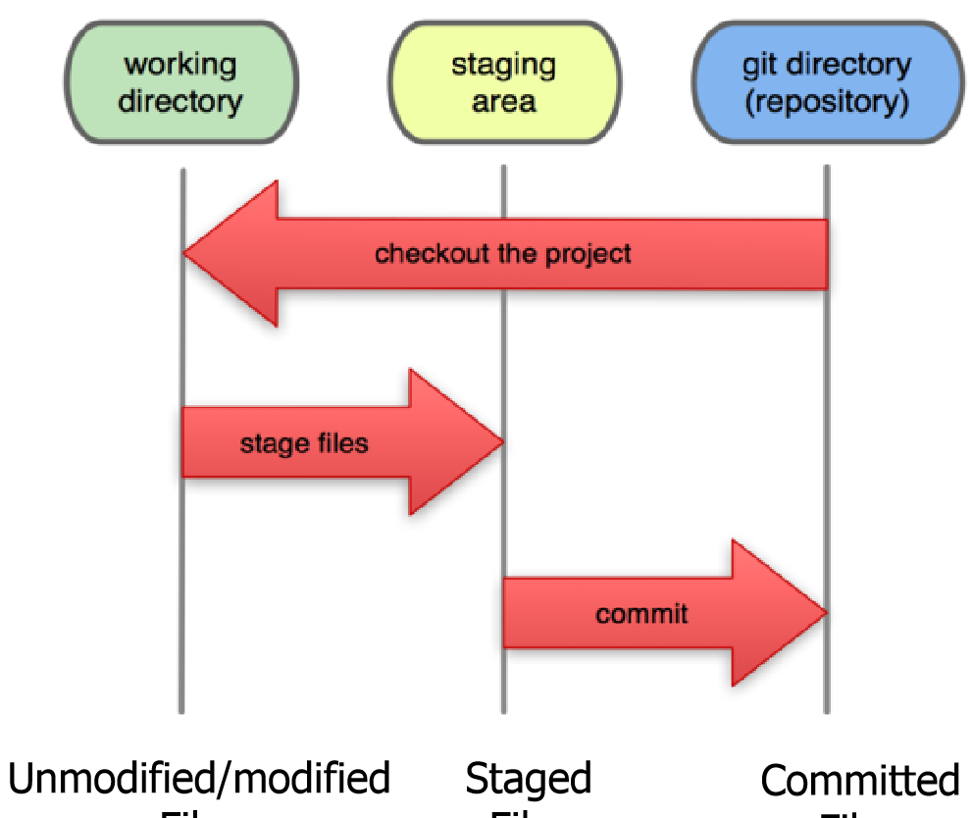
Local Git States
Files can be
  In your local repository
    once committed
  Checked out and/or modified
    In your working directory(working copy)
  Staged (using git add)
    Ready to be committed
A Commit saves a “snapshot” of (and only of) staged changes.
  REMEMBER: JUST BECAUSE YOU SAVED A FILE DOESN’T MEAN GIT WILL INCLUDE IT IN THE REPO. IT MUST BE STAGED FIRST.

Slide 8
Typical Git Workflow
Edit your files in the working directory
Stage files once your happy with them(e.g. the script works!)
Commit at significant junctures (e.g. functionality finished, embarking on significant code changes/refactoring, publishing work)
Untracked
Unmodified
Modified
Staged
Add file(s) to working dir
Edit file(s)
Stage file(s)
Remove File(s)
Commit

Slide 9
Multiple Commits
master
A
B
C
$ git add README.md
$ git commit –m “updated read me”
[master (root-commit) 7d738f4] ….
$ git add --all
$ git commit –m “updated read me again”
[master (root-commit) 627d8h4] ….
Notes:
a set of commits, moving master and our current pointer (*) along. Master is the name of the default branch that git creates for you when first creating a repo. In most cases, "master" means "the main branch". In this case it points to the current commit your repo is on. So after your initial commit it will point to A in this case. As you’ll see later I can reset master to point at a different snapshot of the repo at any time.
9

Slide 10
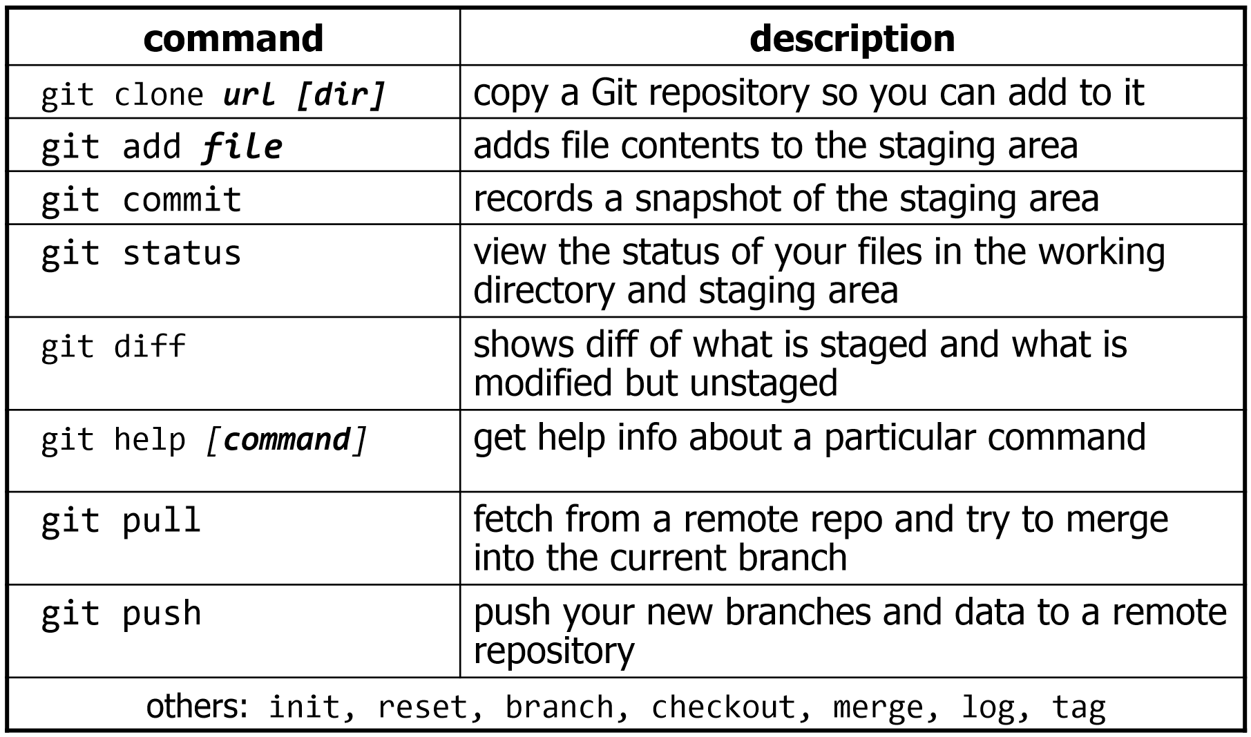
Popular Git Commands

Slide 11
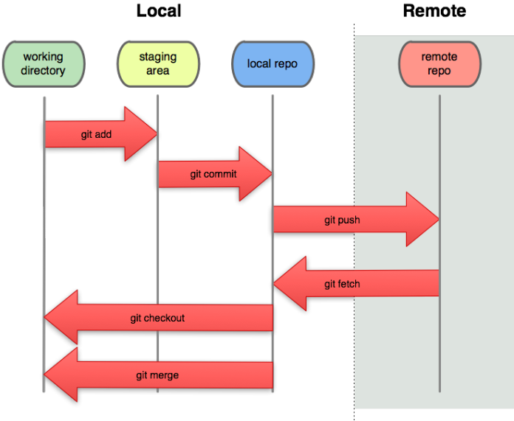
Remote Repositories
Online storage providers of Git repositories include Github and Bitbucket.
  – You can create a remote repo there and push code to it.
  – Many dev teams used/collaborate with them in various modes
  – You can get free space for open source and private projects
This Photo by Unknown Author is licensed under CC BY-SA

Slide 12
Adding a Remote Repo to Existing Project
git remote add origin https://github.com/fxwalsh/msc-2019.git
git remote -v
origin https://github.com/fxwalsh/msc-2019.git(fetch)
origin https://github.com/fxwalsh/msc-2019.git(push)

Slide 13
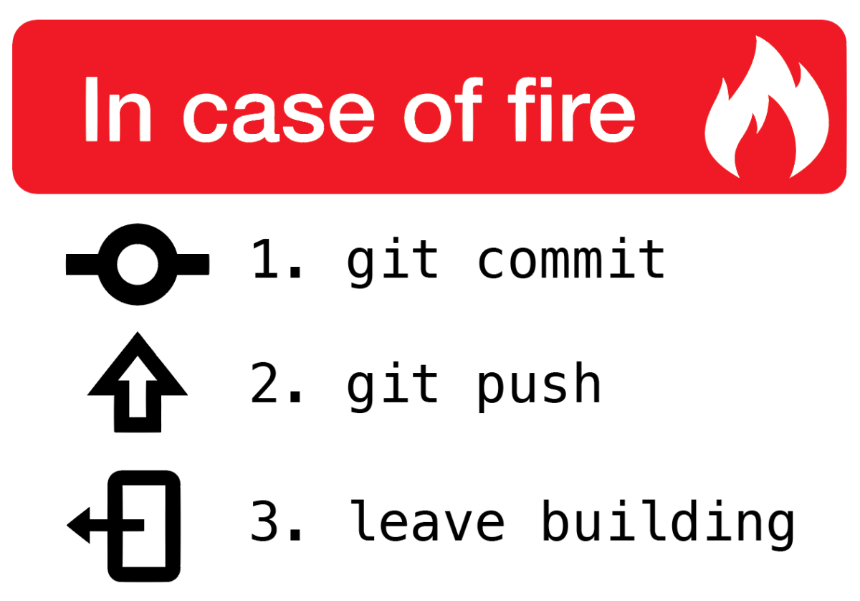
git push
Pushes your changes to remote
Changes will be rejected if newer changes exist on remote
Good idea to pull then push
  merge locally, then push the results.

Slide 14
Pushing to remote
By default, remote repo is labelled origin.
To stage, commit, and push all your latest changes to origin…
git add --all
git commit –m “some important update to important stuff”
git push origin master

Slide 15
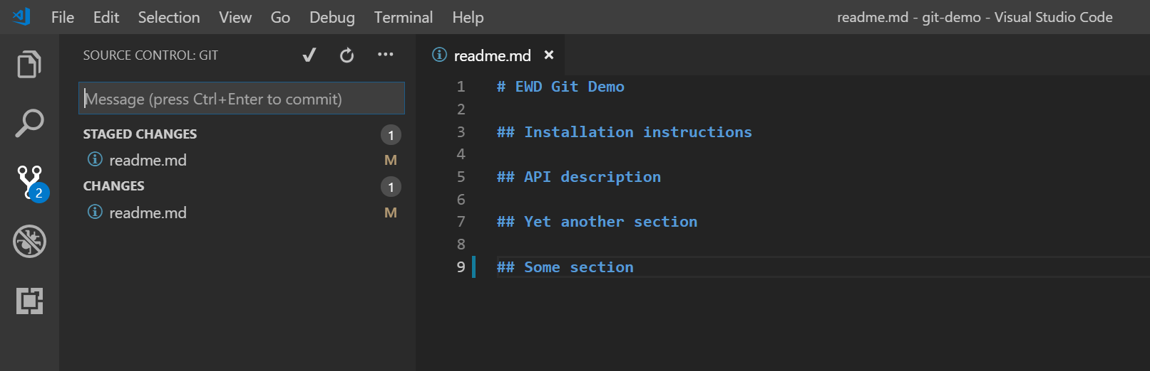
Git in VS Code

Slide 16
Potential situation 1
$ git push
To https://github.com/fxwalsh/project2.git
! [rejected] master -> master (fetch
first) error: failed to push some refs
….
$git pull
…..
Merge made by the 'recursive' strategy.
README.md | 2 +-
1 file changed,1 insertion(+), 1 deletion(-)
$git push
Counting objects: 5, done.
…
I can’t push to origin, it’s saying “! [rejected] master -> master (fetch first)”
Probably changes on the remote repo that you don’t have locally.
Solution: Do a pull then push.
Should work as long and there’s no conflict

Slide 17
Potential situation 2
I want to replace local repo with remote, don’t care about losing changes
Solution: fetch from the default remote, origin
Reset your current branch (master) to origin's master
$ git fetch
…
$ git reset --hard origin/master

Slide 18
Potential situation 3
I want to replace remote repo with local, don’t care about losing changes on remote
Solution: force the push
$ git push -f origin master

Slide 19
Potential situation 4
Trying to pull but getting “CONFLICT (content): Merge conflict in ….”
Two different versions of the same file(s)
Decide which one you want to keep manually.
Perhaps force push or hard reset….
  d
  Se
$ git push -f origin master

Slide 20
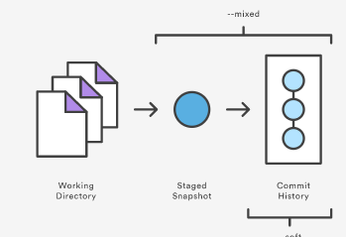
Potential Situation 5
I committed stuff I really didn’t want to. I want to revert to the previous commit.
git reset HEAD~1
  Moves Head(pointer to latest Commit) back one
  Leaves files alone (but not staged)
git reset –hard HEAD~1
  Nuclear option. Gets rid of changes completely (including working dir)
git reset –soft HEAD~1
  Leaves changes staged but resets head to previous commit

Slide 21
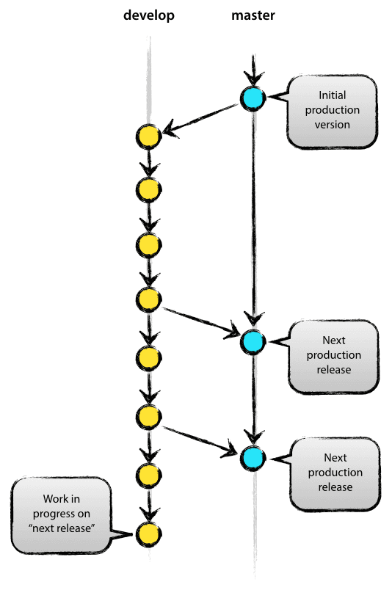
Branching and Merging
Can have multiple local branches that can be entirely independent of each other.
Allows:
  Role based codelines: (branch for production/testing/bug fixing)
  Disposable experimentation: Try something new – if it doesn’t fly, delete the branch.
Probably not vital when just 1 person/1 repo assignment.
  But if trying multiple approaches/features…
This Photo by Unknown Author is licensed under CC BY-SA

